Slide 1
Cardiovascular risk Prediction
CAPSTONE PROJECT
Presented By:
Rajesh Aligeti
B V Raju Institute of Technology , Narsapur .
B.Tech (Computer Science)

Slide 2
OUTLINE
Problem Statement (Should not include solution)
Proposed System/Solution
System Development Approach (Technology Used)
Result
Conclusion
Future Scope
References

Slide 3
Problem Statement
The dataset is from an ongoing cardiovascular study on residents of the town of Framingham, Massachusetts. The classification goal is to predict whether the patient has a 10-year risk of future coronary heart disease (CHD). The dataset provides the patients’ information. It includes over 4,000 records and 15 attributes. Each attribute is a potential risk factor. There are both demographic, behavioral, and medical risk factors.

Slide 4
Proposed Solution
Data Preprocessing: The process begins with cleaning and preprocessing the dataset to handle missing values, normalize features, and address class imbalance using techniques like SMOTE.
Feature Engineering: Key features relevant to heart disease risk, such as age, BMI, smoking history, and physical activity, are selected and transformed to improve model accuracy.
Model Training: Various machine learning algorithms, including Logistic Regression, are trained on the processed dataset to predict the risk of heart disease. Hyperparameter tuning is performed to optimize model performance.
Evaluation and Validation: The trained models are evaluated using metrics such as accuracy, precision, recall, F1-score, and ROC-AUC to assess their effectiveness. Confusion matrices and classification reports provide detailed insights into model performance.
Visualization: Key performance metrics are visualized using bar plots and ROC curves to provide a clear and comprehensive understanding of the model's effectiveness.

Slide 5
System Approach
System requirements : windows 11 operating system , 16GB RAM, I5 Processor
Library required to build the model : Google Colab

Slide 6
Result
The project successfully developed a predictive model to identify the risk of heart disease using patient health indicators. This model aims to aid healthcare professionals in early detection and intervention strategies for heart disease. The model was trained and evaluated on a dataset of 61,771 records each containing various health metrics such as general health status, checkup frequency, exercise habits, history of heart disease, presence of other chronic conditions, and lifestyle factors like smoking history, alcohol consumption, and dietary habits. This comprehensive dataset allowed for a robust analysis and modeling approach.

Slide 7
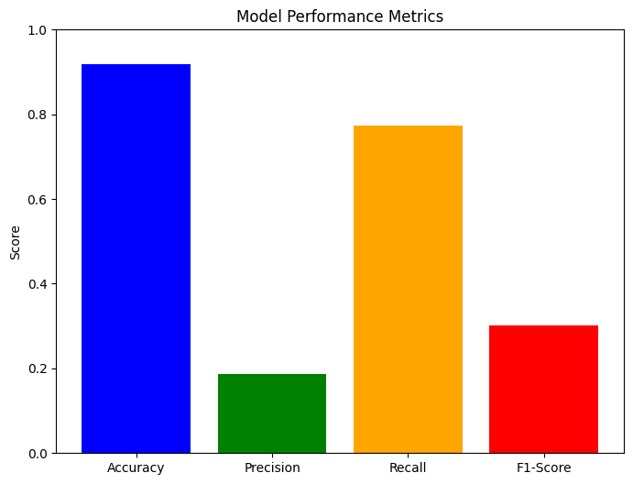
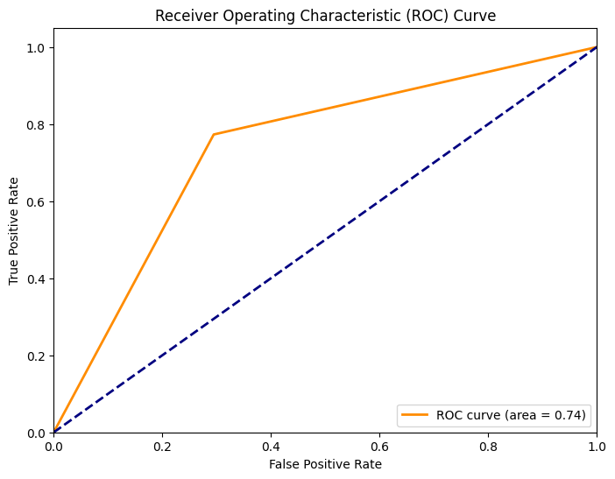
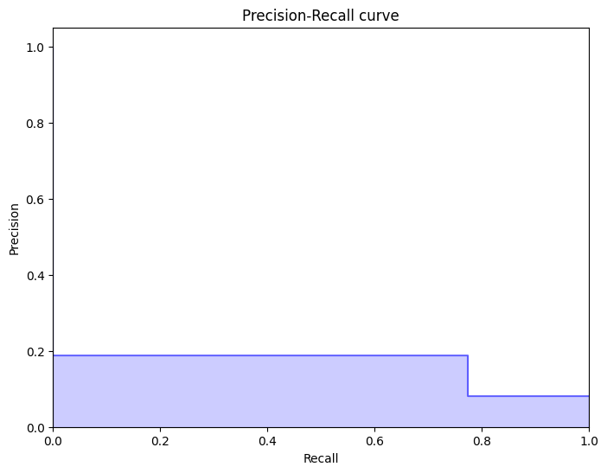
Result

Slide 8
Conclusion
In conclusion, the development of a predictive model for identifying the risk of heart disease provides a practical solution to enhance early detection and intervention strategies for healthcare professionals. By leveraging patient health indicators and addressing class imbalance, the model effectively predicts heart disease risk, offering timely and accurate assessments. With its comprehensive dataset and advanced modeling techniques, the project ensures continuous improvement and optimization, ultimately contributing to a more effective and efficient approach to heart disease prevention and management for both patients and healthcare providers.

Slide 9
Future scope
Incorporation of Genetic Data: Integrate genetic data to assess genetic predispositions to cardiovascular diseases. Develop polygenic risk scores based on genetic variants associated with CHD.
Personalized Medicine: Develop models that provide personalized risk assessments based on individual characteristics and profiles. Recommend personalized interventions based on predicted risk scores.
Integration with Healthcare Systems : Integrate predictive models into electronic health records (EHR) to support clinical decision-making. Use predictive analytics to identify at-risk populations for targeted interventions and preventive strategies.
Real-time Monitoring and Predictive Analytics: Implement systems for real-time monitoring of risk factors and updating risk predictions dynamically.
Collaborative Research: Collaborate with healthcare professionals and researchers to refine the model and validate its clinical utility. Publish findings in scientific journals and present them at conferences to contribute to the broader scientific community.

Slide 10
References
IBM Watsonx AI tutorial

Slide 11
Github link
Link: https://github.com/Rajeshaligeti/Rajesh-Aligeti/blob/main/Cardiovascular_Risk_Prediction.ipynb

Slide 12
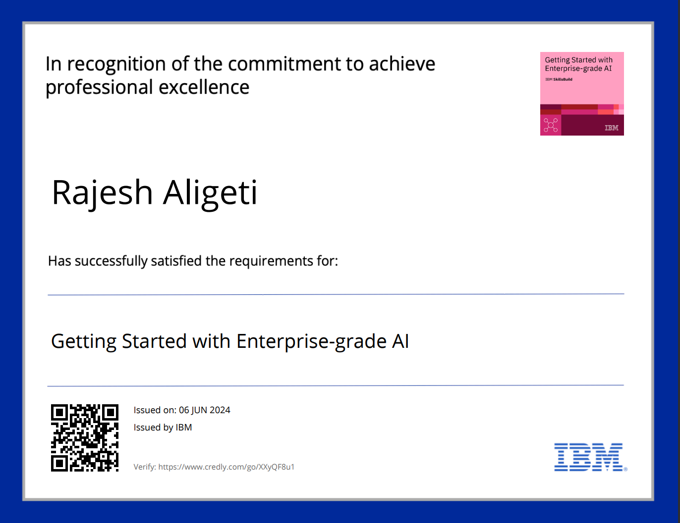
course certificate 1

Slide 13
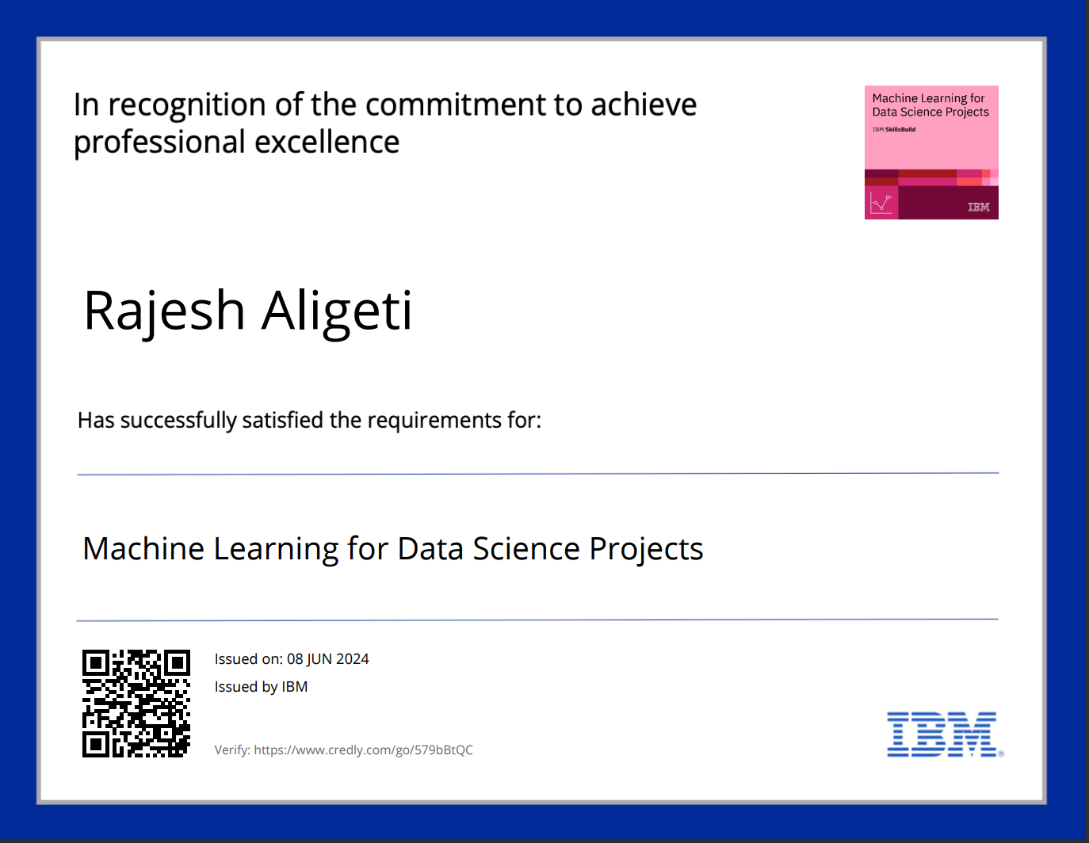
course certificate 2

Slide 14
THANK YOU

